Slide 1
ECEG-5193: Algorithm Analysis and Design
Analysis of Sorting and Searching algorithms
Trees

Slide 2
Outline
Preliminaries
What is Tree?
Implementation of Trees using C++
Tree traversals and applications
Binary Trees
Binary Search Trees
Structure and operations
Analysis
AVL Trees

Slide 3
What is a Tree?
A tree is a collection of nodes with the following properties:
The collection can be empty.
Otherwise, a tree consists of a distinguished node r, called root, and zero or more nonempty sub-trees T₁, T₂, … , T_{k}, each of whose roots are connected by a directed edge from r.
The root of each sub-tree is said to be child of r, and r is the parent of each sub-tree root.
If a tree is a collection of N nodes, then it has N-1 edges.
root
T₁
T₂
...
T_{k}

Slide 4
Preliminaries
A
B
C
D
E
F
G
H
I
J
K
L
M
N
P
Q
Node A has 6 children: B, C, D, E, F, G.
B, C, H, I, P, Q, K, L, M, N are leaves in the tree above.
K, L, M are siblings since F is parent of all of them.

Slide 5
Preliminaries (continued)
A path from node n₁ to n_{k} is defined as a sequence of nodes n₁, n₂, …, n_{k} such that n_{i} is parent of n_{i+1} (1 ≤i < k)
The length of a path is the number of edges on that path.
There is a path of length zero from every node to itself.
There is exactly one path from the root to each node.
The depth of node n_{i} is the length of the path from root to node n_{i}
The height of node n_{i} is the length of longest path from node n_{i} to a leaf.
If there is a path from n₁ to n₂, then n₁ is ancestor of n₂, and n₂ is descendent of n₁.
If n₁ ≠ n₂ then n₁ is proper ancestor of n₂, and n₂ is proper descendent of n₁.

Slide 6
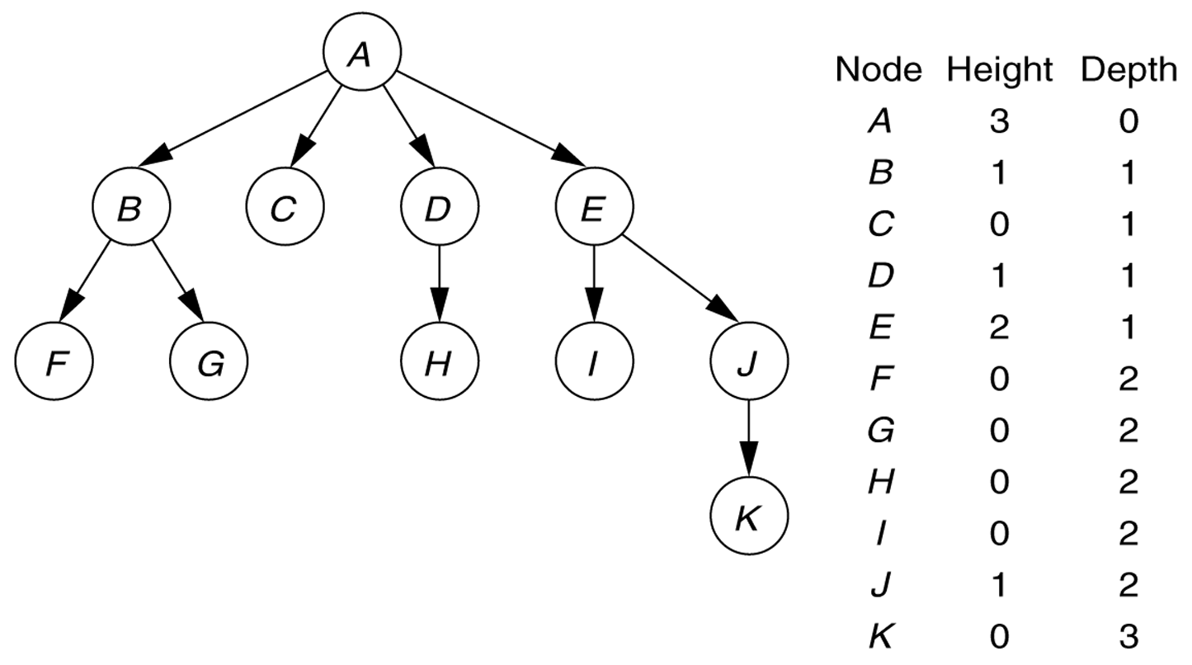
Figure 1
A tree, with height and depth information

Slide 7
Implementation of Trees
A
element
struct TreeNode {
Object element;
struct TreeNode *firstChild;
struct TreeNode *nextSibling;
};
firstChild
NULL
nextSibling
B
C
D
NULL
NULL
A
H
NULL
NULL
B
C
D
E
F
G
H
I
J
K
L
M
N
P
Q

Slide 8
Binary Trees
A binary tree is a tree in which no node can have more than two children
The depth can be as large as N-1 in the worst case.
root
A binary tree consisting
of a root and
two subtrees T_{L} and T_{R},
both of which could
possibly be empty.
T_{L}
T_{R}
The depth of node n_{i} is the length of the path from root to node n_{i}
The height of node n_{i} is the length of longest path from node n_{i} to a leaf.
Non-binary tree

Slide 9
Binary Tree Terminology
Left Child – The left child of node n is a node directly below and to the left of node n in a binary tree.
Right Child – The right child of node n is a node directly below and to the right of node n in a binary tree.
Left Subtree – In a binary tree, the left subtree of node n is the left child (if any) of node n plus its descendants.
Right Subtree – In a binary tree, the right subtree of node n is the right child (if any) of node n plus its descendants.

Slide 10
Binary Tree -- Example
A is the root.
B is the left child of A, and
C is the right child of A.
D doesn’t have a right child.
H doesn’t have a left child.
B, F, G and I are leaves.
• A
• B
• C
• D
• E
• F
• G
• H
• I

Slide 11
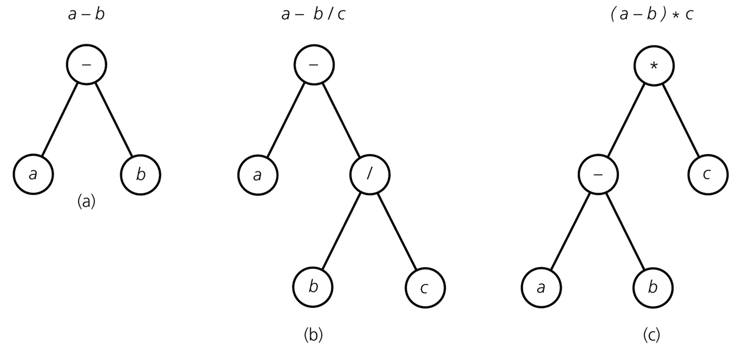
Binary Tree – Representing Algebraic Expressions
Preorder traversal: left-Root-right

Slide 12
Height of Binary Tree
The height of a binary tree T can be defined recursively as:
If T is empty, its height is -1.
If T is non-empty tree, then since T is of the form
r
T_{L} T_{R}
the height of T is 1 greater than the height of its root’s taller subtree; i.e.
height(T) = 1 + max{height(T_{L}), height(T_{R})}

Slide 13
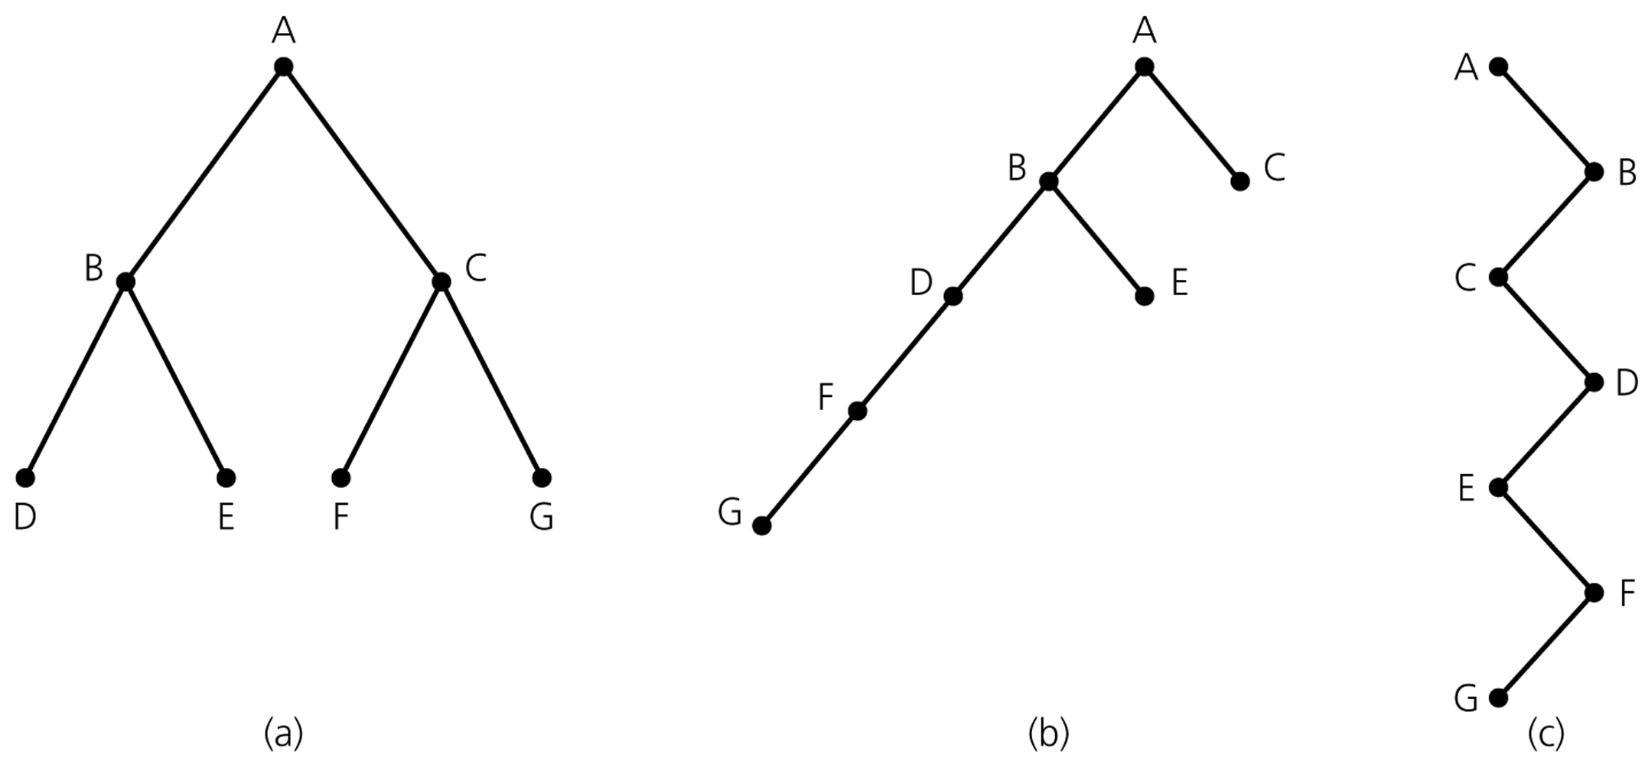
Height of Binary Tree (cont.)
Binary trees with the same nodes but different heights

Slide 14
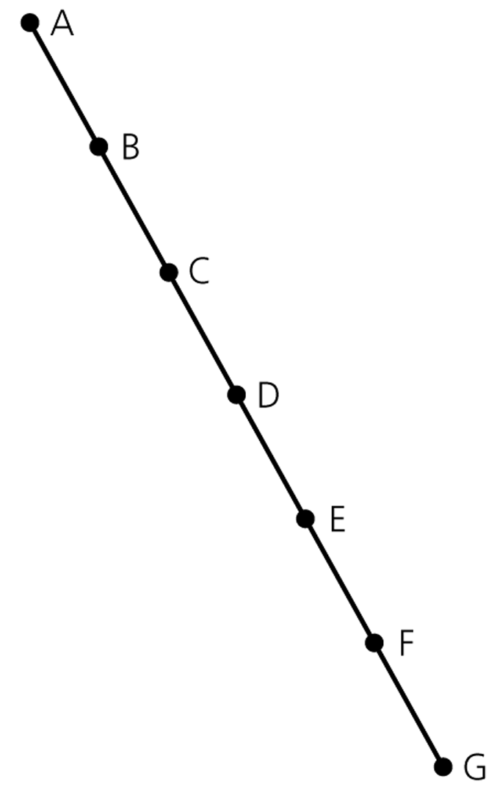
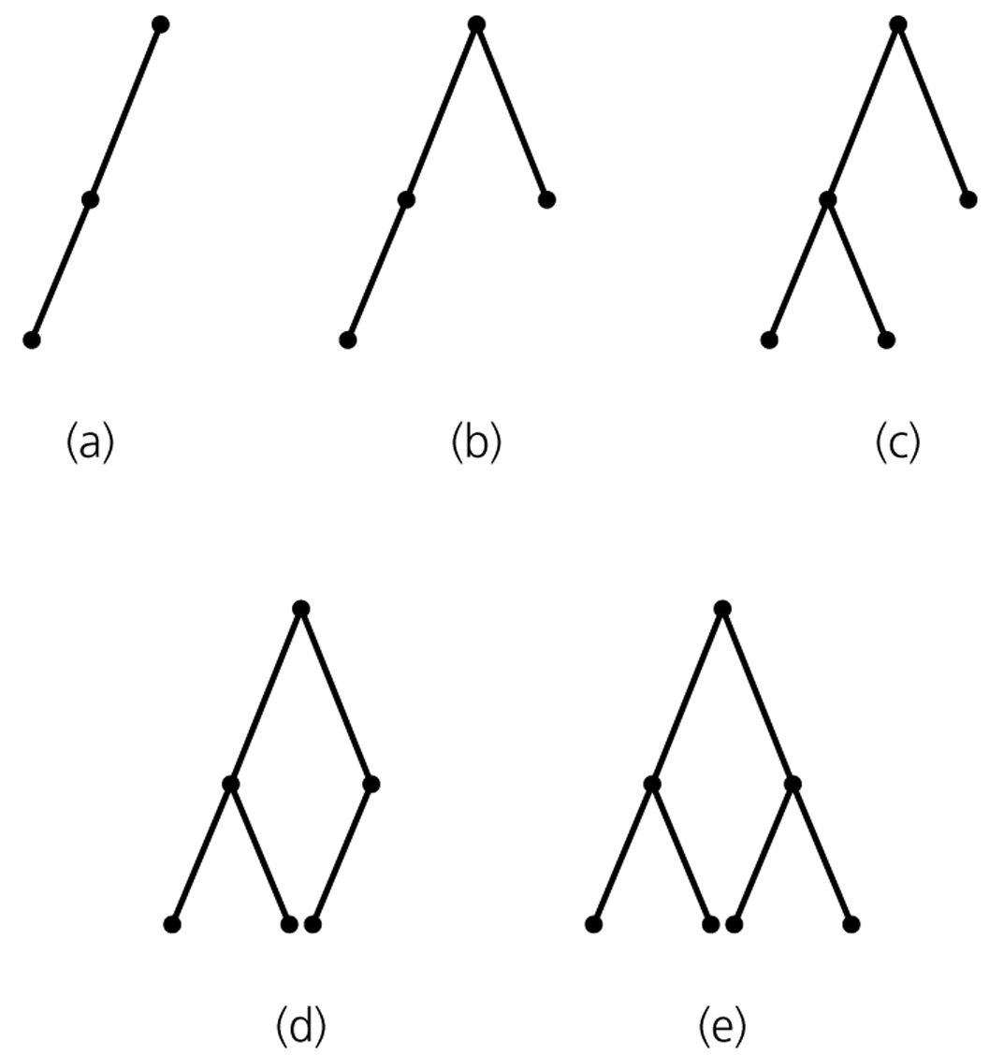
Maximum and Minimum Heights of a Binary Tree
The maximum height of a binary tree with N nodes is N-1.
Each level of a minimum height tree, except the last level, must contain as many nodes as possible.
A maximum-height binary tree
with seven nodes
Some binary trees of height 2
All but (a) is minimum-height

Slide 15
Some Height Theorems
Theorem 1: The maximum number of nodes that a binary tree of height h can have is 2^{h+1}-1.
Theorem 2: The minimum height of a binary tree with N nodes is ⎡log₂(N+1)-1⎤ .
Let’s prove these two theorems.

Slide 16
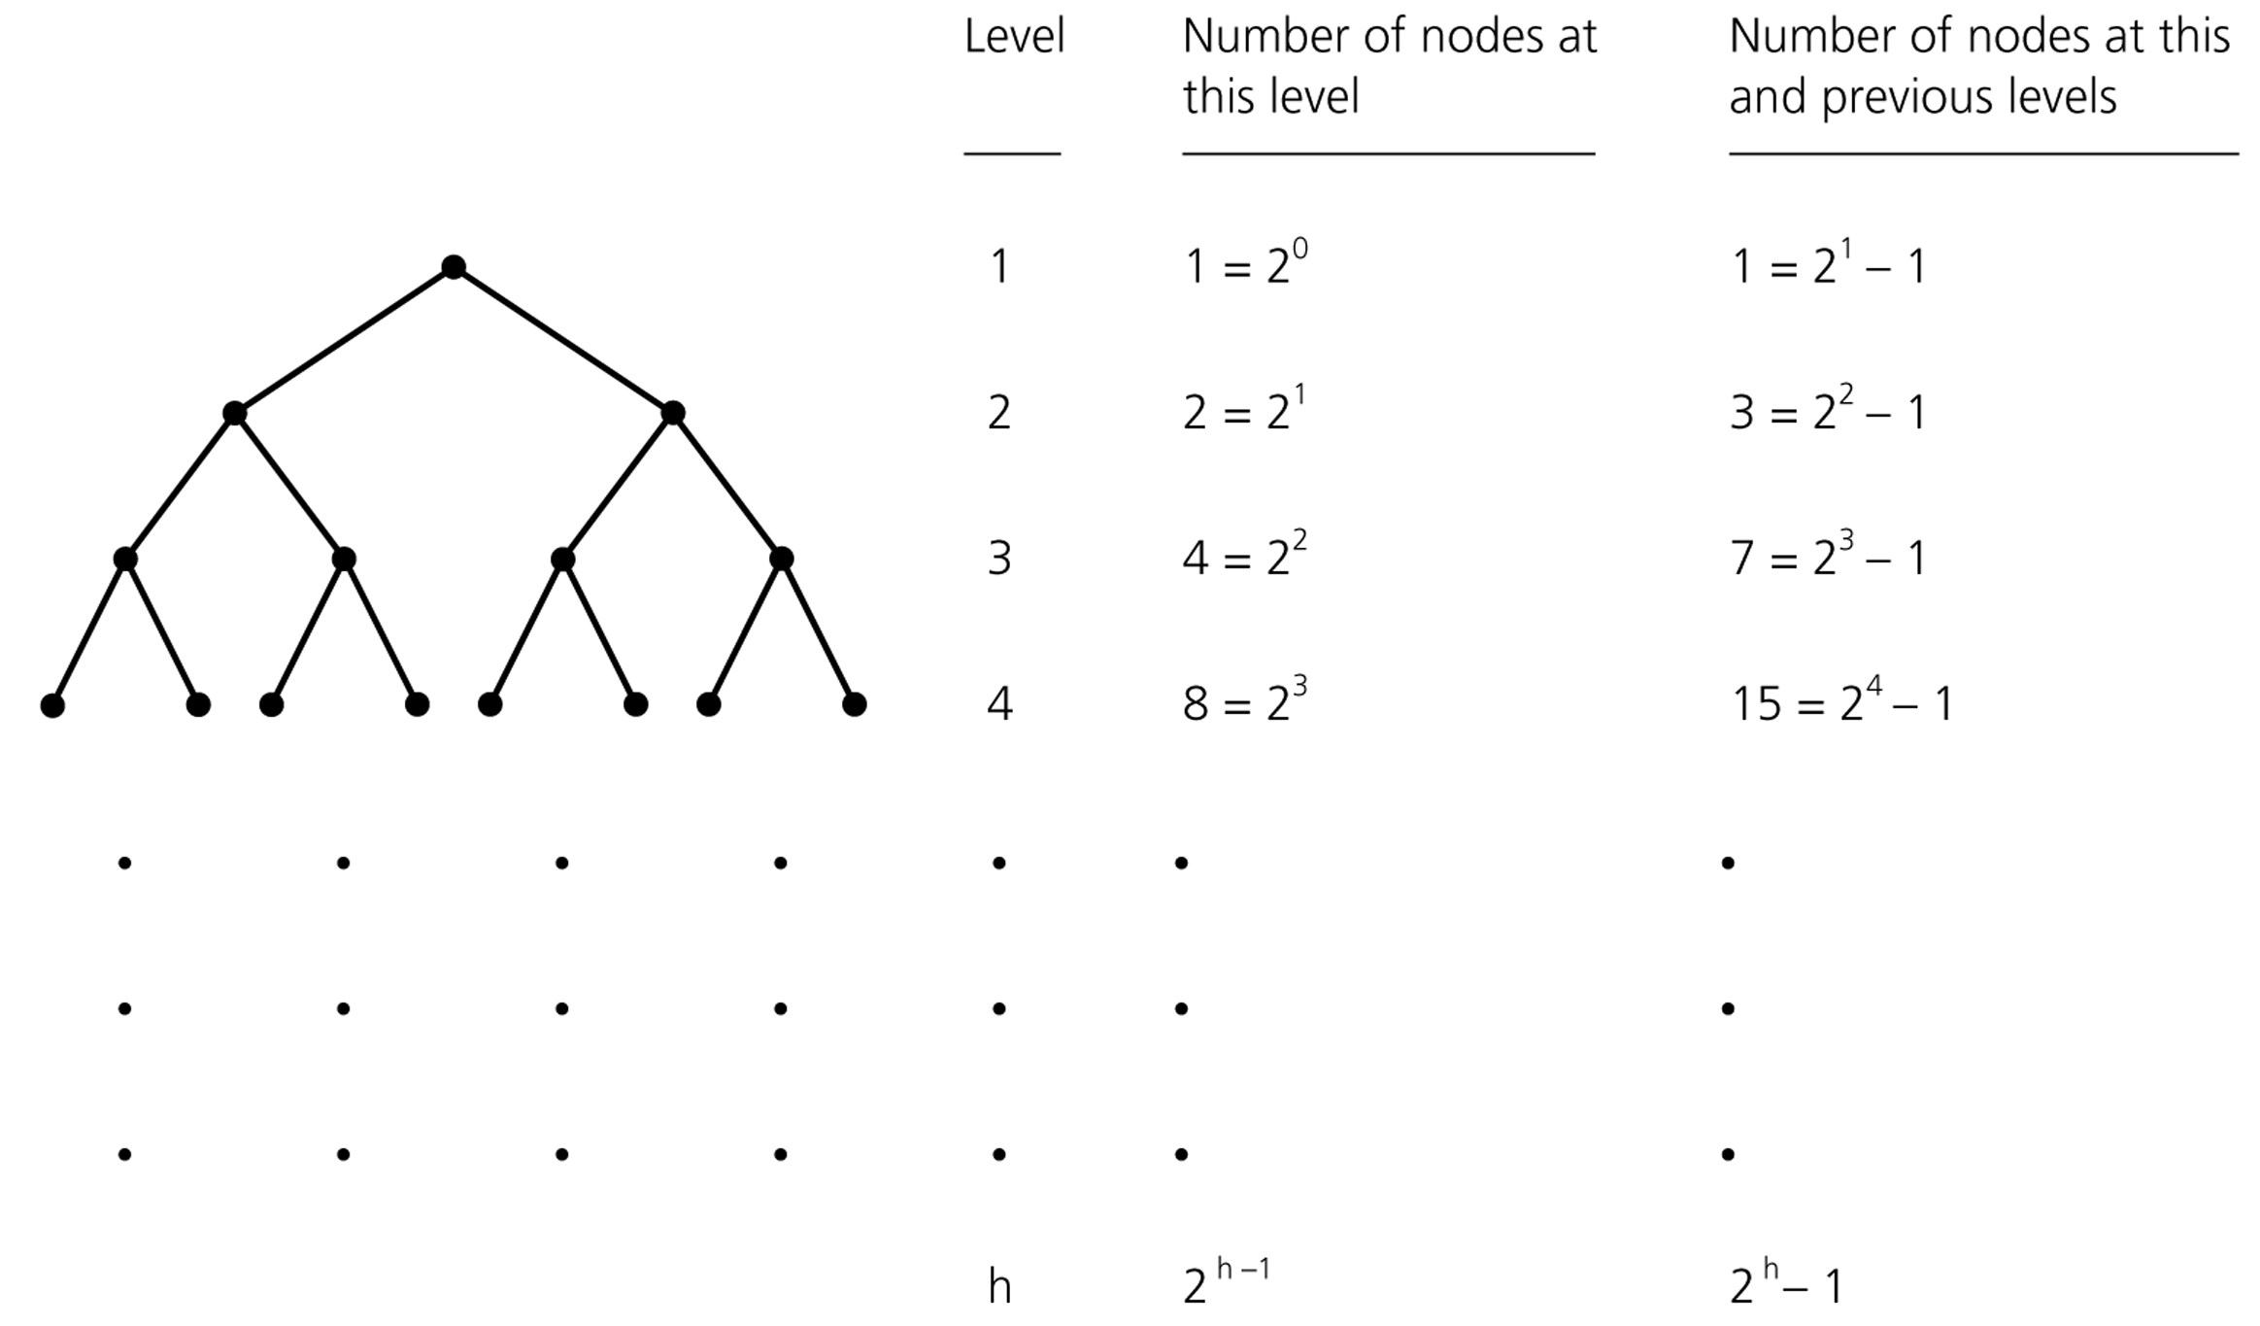
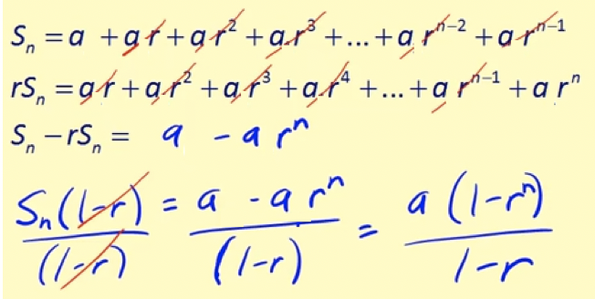
Counting the nodes in a binary tree
Height
--------
0
1
2
3
h-1
h
Theorem 1:
N = 2⁰ + 2¹ + 2² + .. + 2^{h-1}+ 2^{h}
= 1*(1-2^{h+1}) / (1-2) = 2^{h+1}-1
Use telescopic series to prove it.

Slide 17
Counting the nodes in a binary tree
Height
--------
Theorem 1:
N = 2⁰ + 2¹ + 2² + .. + 2^{h-1}+ 2^{h}
= 1*(1-2^{h+1}) / (1-2) = 2^{h+1}-1
This is the max # of nodes for height h, as we cannot insert one node without increasing the height. So, in general N <= 2^{h+1}-1
0
1
2
3
h-1
h

Slide 18
Counting the nodes in a binary tree
Height
--------
Theorem 2:
N = 2^{h+1}-1
N+1=2^{h+1} //take logs of sides
log(N+1) = log(2^{h+1}) = h+1
h = log(N+1)-1
This is the minimum height when N+1 is a power of 2.
Height does not change when some nodes missing at the last level, e.g., N+1=13 instead of 16.
Same h must be produced there.
So, in general h = ⎡log₂(N+1)-1⎤
0
1
2
3
h-1
h

Slide 19
Number of Binary trees with Same # of Nodes
n=0 ➔ empty tree
n=1 ➔
•
(1 tree)
•
•
n=2 ➔
(2 trees)
•
•
n=3 ➔
(? trees)

Slide 20
Number of Binary trees with Same # of Nodes
n=0 ➔ empty tree
n=1 ➔
•
(1 tree)
•
•
n=2 ➔
(2 trees)
•
•
n=3 ➔
•
•
•
•
•
•
•
(5 trees)
•
•
•
•
•
•
•
•

Slide 21
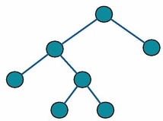
Full Binary Tree
In a full binary tree a tree in which every node in the tree has either 0 or 2 children

Slide 22

Full Binary Tree – Example
A full binary tree of height 2

Slide 23
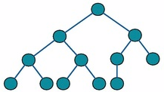
Complete Binary Tree
In a complete binary tree every level, except possibly the last, is completely filled, and all nodes in the last level are as far left as possible

Slide 24
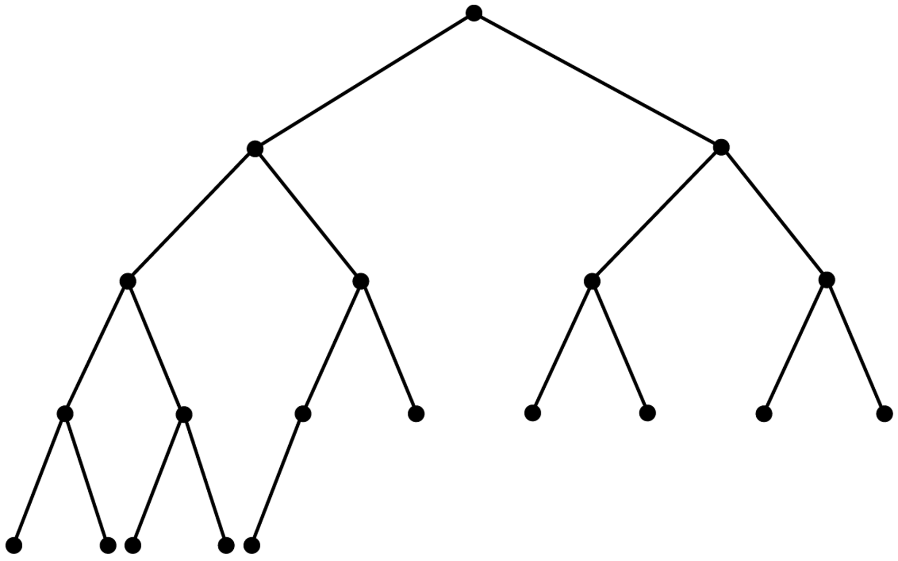
Complete Binary Tree – Example

Slide 25
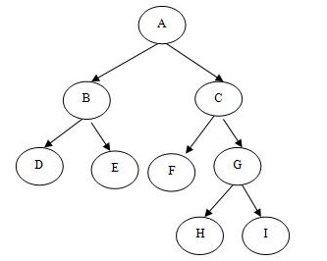
Full but Not Complete Binary Tree – Example

Slide 26

Neither Full Nor Complete Binary Tree – Example

Slide 27
Full and Complete Binary Tree – Example

Slide 28
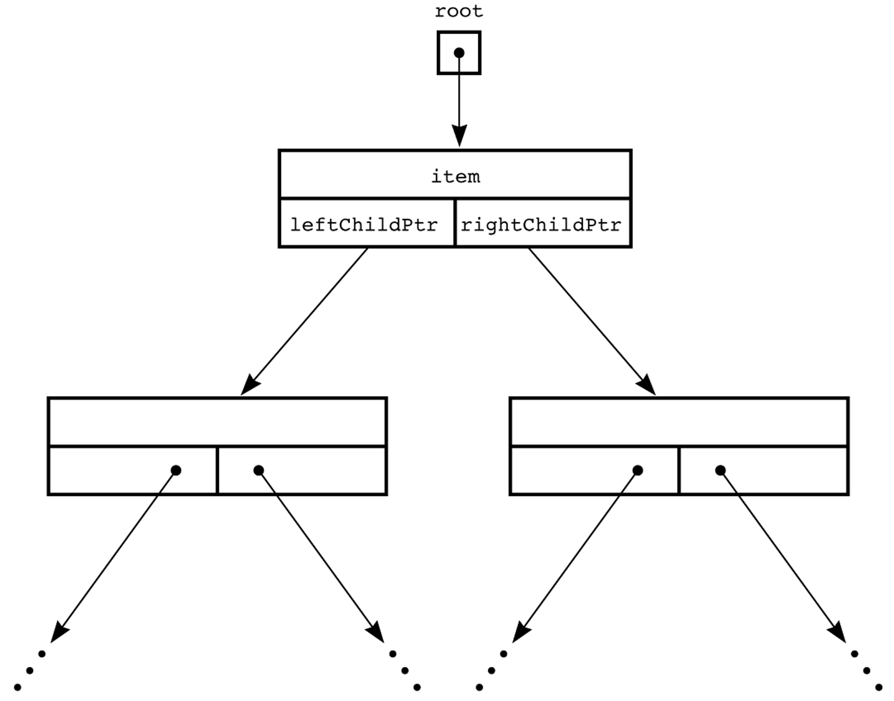
A Pointer-Based Implementation of Binary Trees
struct BinaryNode {
Object element;
struct BinaryNode *left;
struct BinaryNode *right;
};

Slide 29
Implementation: Tree Nodes
Using a typedef statement:
struct BinaryTreeNode
{
typedef string Item;
Item data;
BinaryTreeNode *left;
BinaryTreeNode *right;
};
Using a template parameter:
template <class Item>
struct BinaryTreeNode
{
Item data;
BinaryTreeNode *left;
BinaryTreeNode *right;
};

Slide 30
Binary Tree Represented with BinaryTreeNode Structs
Using a template parameter:
template <class Item>
struct BinaryTreeNode
{
Item data;
BinaryTreeNode *left;
BinaryTreeNode *right;
};
‘A’
‘L’
‘G’
‘R’
‘T’
‘O’

Slide 31
‘A’
‘L’
‘G’
root_ptr
‘O’
‘R’
‘T’
data ‘A’
left
right
data ‘L’
data ‘G’
left
right
left
right
data ‘O’
data ‘R’
data ‘T’
left
right
left
right
left
right

Slide 32
Depth of Complete Binary Tree
Given a complete binary tree of N nodes, what is the depth?
D = 0
N = 1
D = 1
N = 3
D = 1
N = 2
D = 2
N = 7
D = 2
N = 4
D = floor(log N) = O(log N)

Slide 33
Depth of Binary Tree
Given a binary tree of N nodes, what is the maximum possible depth?
D = 0
N = 1
D = 2
N = 3
D = 4
N = 5
D = O(N)

Slide 34
Summary
Binary trees contain nodes.
Each node may have a left child and a right child.
If you start from any node and move upward, you will eventually reach the root.
Every node except the root has one parent. The root has no parent.
Complete binary trees require the nodes to fill in each level from left-to-right before starting the next level.
Notes:
A quick summary . . .

Slide 35
Binary Search Trees
An important application of binary trees is their use in searching.
Binary search tree is a binary tree in which every node X contains a data value that satisfies the following:
all data values in its left subtree are smaller than the data value in X
the data value in X is smaller than all the values in its right subtree.
the left and right subtrees are also binary search tees.

Slide 36
Example
6
6
2
8
2
8
1
4
1
4
3
3
7
A binary search tree
Not a binary search tree, but a binary tree

Slide 37
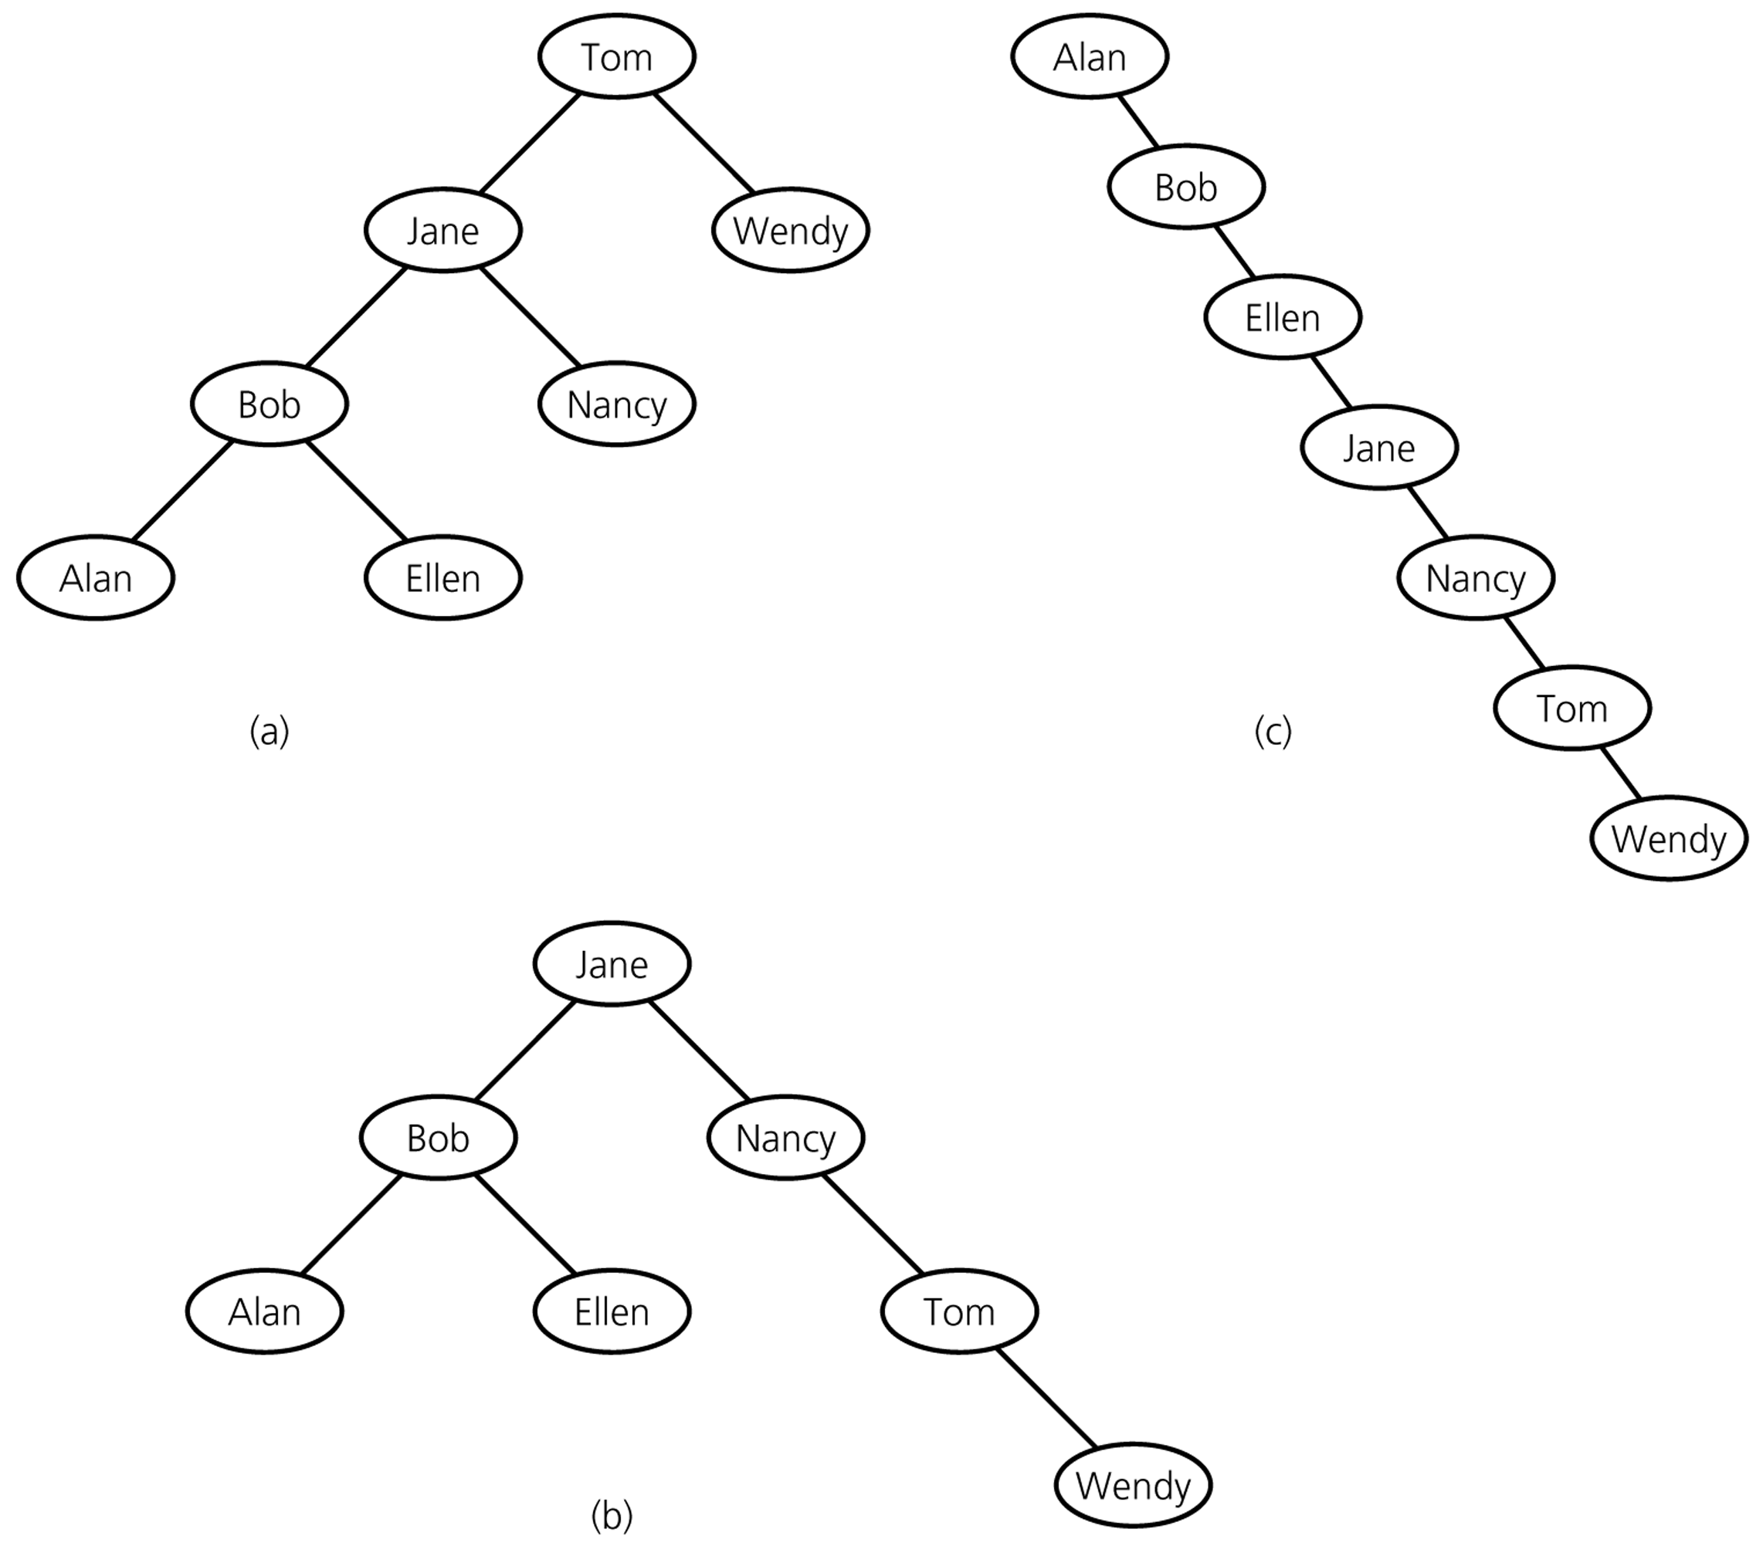
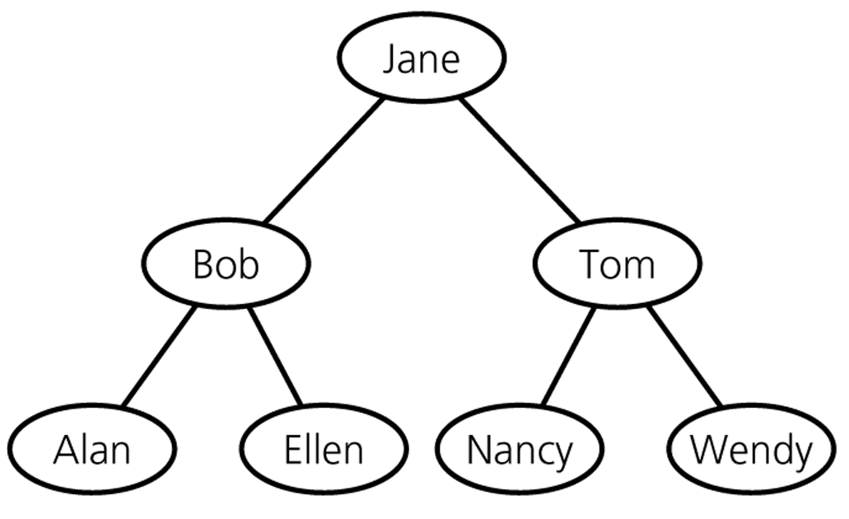
Binary Search Trees – containing same data

Slide 38
Operations on BSTs
Most of the operations on binary trees are O(logN).
This is the main motivation for using binary trees rather than using ordinary lists to store items.
Most of the operations can be implemented using recursion.
we generally do not need to worry about running out of stack space, since the average depth of binary search trees is O(logN).

Slide 39
The BinaryNode class
template <class T>
class BinaryNode
{
T element; // this is the item stored in the node
BinaryNode *left;
BinaryNode *right;
BinaryNode( const T & theElement, BinaryNode *lt,
BinaryNode *rt ) : element( theElement ), left( lt ), right( rt ) { }
};

Slide 40
find
/**
* Method to find an item in a subtree.
* x is item to search for.
* t is the node that roots the tree.
* Return node containing the matched item.
*/
template <class T>
BinaryNode<T> *
find( const T & x, BinaryNode<T> *t ) const
{
if( t == NULL )
return NULL;
else if( x < t->element )
return find( x, t->left );
else if( t->element < x )
return find( x, t->right );
else
return t; // Match
}

Slide 41
findMin (recursive implementation)
/**
* method to find the smallest item in a subtree t.
* Return node containing the smallest item.
*/
template <class T>
BinaryNode<T> *
findMin( BinaryNode<T> *t ) const
{
if( t == NULL )
return NULL;
if( t->left == NULL )
return t;
return findMin( t->left );
}

Slide 42
findMax (nonrecursive implementation)
/**
*method to find the largest item in a subtree t.
*Return node containing the largest item.
*/
template <class T>
BinaryNode<T> *
findMax( BinaryNode<T> *t ) const
{
if( t != NULL )
while( t->right != NULL )
t = t->right;
return t;
}

Slide 43
Insert operation
Algorithm for inserting X into tree T:
Proceed down the tree as you would with a find operation.
if X is found
do nothing, (or “update” something) else
insert X at the last spot on the path traversed.

Slide 44
Insert 5
Example
6
2
8
1
4
3
5
What about duplicates?

Slide 45
Insertion into a BST
/* method to insert into a subtree.
* x is the item to insert.
* t is the node that roots the tree.
* Set the new root.
*/
template <class T>
void insert( const T & x,
BinaryNode<T> * & t ) const
{
if( t == NULL )
t = new BinaryNode<T>( x, NULL, NULL );
else if( x < t->element )
insert( x, t->left );
else if( t->element < x )
insert( x, t->right );
else
; // Duplicate; do nothing
}

Slide 46
Deletion operation
There are three cases to consider:
Deleting a leaf node
Replace the link to the deleted node by NULL.
Deleting a node with one child:
The node can be deleted after its parent adjusts a link to bypass the node.
Deleting a node with two children:
The deleted value must be replaced by an existing value that is either one of the following:
The largest value in the deleted node’s left subtree
The smallest value in the deleted node’s right subtree.

Slide 47
Deletion – Case1: A Leaf Node
To remove the leaf containing the item, we have to set the pointer in its parent to NULL.
Delete 70 (A leaf node)
50
50
➔
40
60
40
60
30
45
70
30
45
42
42

Slide 48
Deletion – Case2: A Node with only a left child
Delete 45 (A node with only a left child)
50
50
40
60
➔
40
60
30
45
70
30
42
70
42

Slide 49
Deletion – Case2: A Node with only a right child
Delete 60 (A node with only a right child)
50
50
➔
40
70
40
60
70
30
45
30
45
42
42

Slide 50
Deletion – Case3: A Node with two children
Locate the inorder successor of the node.
Copy the item in this node into the node which contains the item which will be deleted.
Delete the node of the inorder successor.
Delete 40 (A node with two children)
50
50
40
60
➔
42
60
30
45
70
30
45
70
42

Slide 51
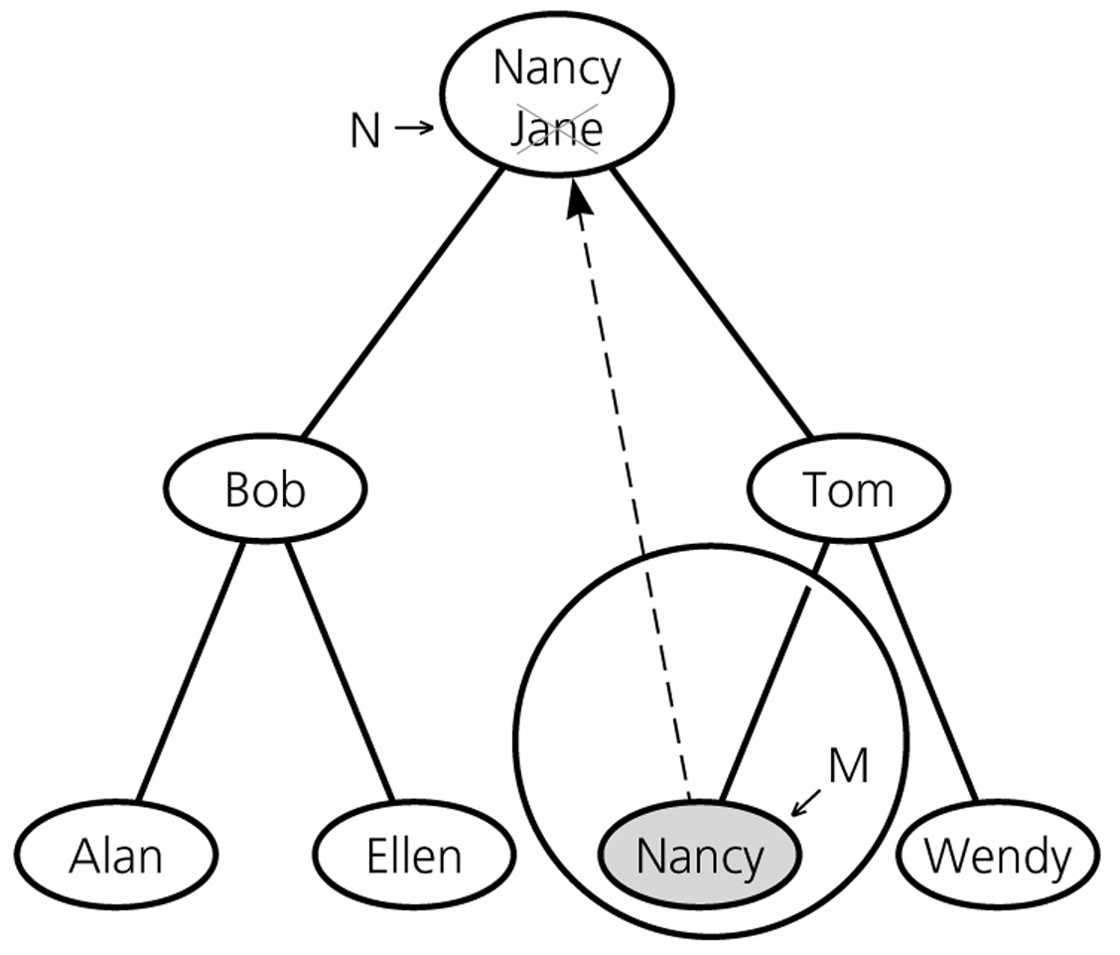
Deletion – Case3: A Node with two children

Slide 52
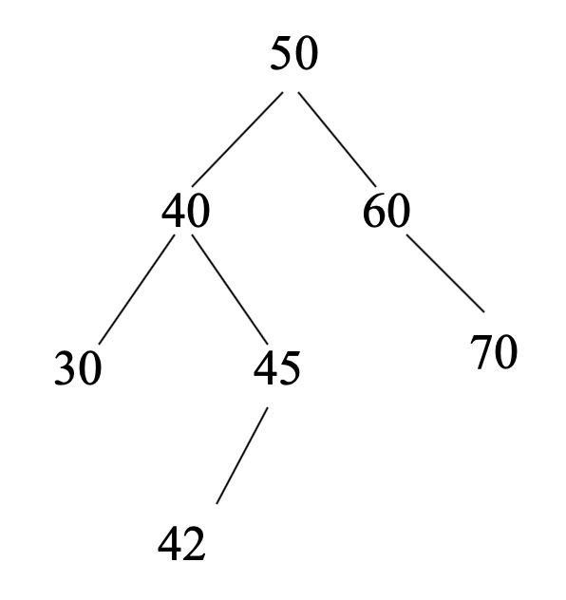
Deletion routine for BST
template <class T>
void remove( const T & x,
BinaryNode<T> * & t ) const
{
if( t == NULL )
return; // Item not found; do nothing
if( x < t->element )
remove( x, t->left );
else if( t->element < x )
remove( x, t->right );
else if( t->left != NULL && t->right != NULL {
t->element = findMin( t->right )->element;
remove( t->element, t->right );
}
else {
BinaryNode<T> *oldNode = t;
t = ( t->left != NULL ) ? t->left : t->right;
delete oldNode;
}
}

Slide 53
Analysis of BST Operations
The cost of an operation is proportional to the depth of the last accessed node.
The cost is logarithmic for a well-balanced tree, but it could be as bad as linear for a degenerate tree.
In the best case we have logarithmic access cost, and in the worst case we have linear access cost.

Slide 54
Minimum Height
Insertion in search-key order produces a maximum-height binary search tree.
Insertion in random order produces a near-minimum-height binary search tree.
That is, the height of an n-node binary search tree is:
Best Case – ⎡log₂(n+1)-1⎤ (see slide 25) ➔ O(log₂n)
Worst Case – n-1 ➔ O(n)
Average Case – close to ⎡log₂(n+1)-1⎤ ➔ O(log₂n)
In fact, 1.39log₂n

Slide 55
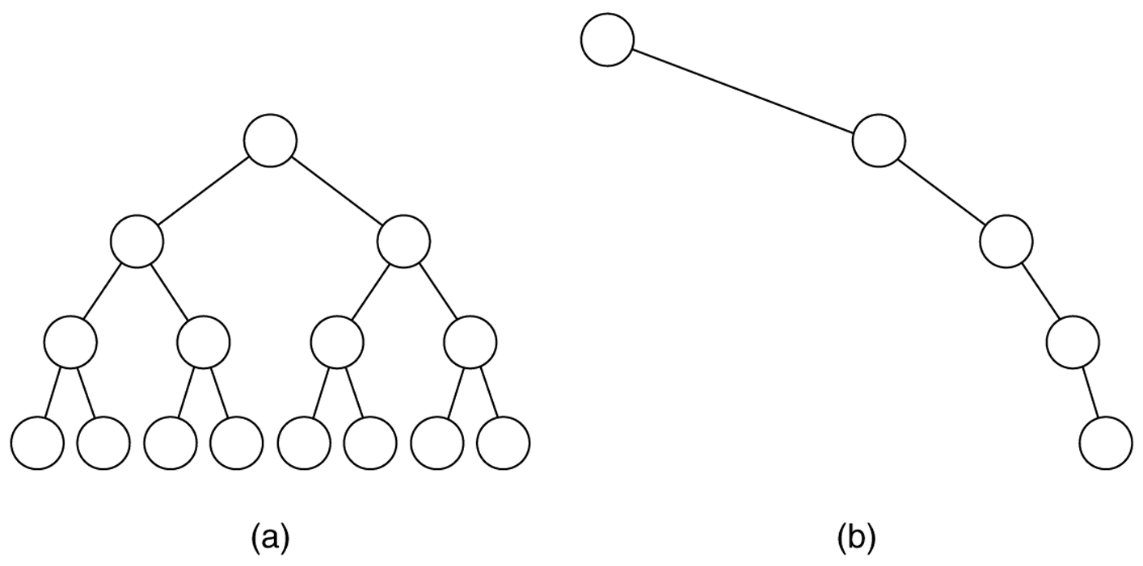
Figure 19.19
(a) The balanced tree has a height of log N; (b) the unbalanced tree has a
height of N – 1. We will study balanced binary search trees next week.

Slide 56
Number of BSTs
Suppose we’re inserting n items into an empty binary search tree to create a
binary search tree with n nodes,
➔ How many different binary search trees with n nodes, and
What are their probabilities,
There are n! different orderings of n keys.
But how many different binary search trees with n nodes?
n=0 ➔ 1 BST (empty tree)
n=1 ➔ 1 BST (a binary tree with a single node)
n=2 ➔ 2 BSTs
n=3 ➔ 5 BSTs

Slide 57
Number of BSTs
•
•
•
•
•
n=3 ➔
•
•
•
•
•
•
•
•
•
•
Probabilities: 1/6 1/6 2/6 1/6 1/6
Insertion Order: 3,2,1 3,1,2 2,1,3 1,3,2 1,2,3
2,3,1
In general, given n elements, the number of binary search trees that can be made from those elements is given by the n^{th} Catalan Number (denoted C_{n}).
(2n)! C_{n} = ---------- (n+1)!n!

Slide 58
Number of BSTs
A cool algorithm for counting. We know n = 0 or 1 → count=1.
Consider n=6 to see the pattern clearly.
1 2 3 .. 6
\ / \ / \ /
[2,3,4,5,6] [1] [3,4,5,6] [1,2] [4,5,6] [1,2,3,4,5]
Root=3 case, for instance, creates 2*3 = 6 BSTs (product rule).
int nBST(int n) {
if (n == 0 || n == 1) return 1;
int count = 0;
for i=1; i<=n; i++
count += nBST(i-1) * nBST(n-i); //product rule
return count; }

Slide 59
Number of BSTs
A cool algorithm for counting. We know n = 0 or 1 → count=1.
Consider n=6 to see the pattern clearly.
1 2 3 .. 6
\ / \ / \ /
[2,3,4,5,6] [1] [3,4,5,6] [1,2] [4,5,6] [1,2,3,4,5]
Speedup by avoiding recomputations via dynamic programming
int nBST(int n, int* results) { //results inited to -1s
if (n == 0 || n == 1) return 1;
int count = 0;
for i=1; i<=n; i++
if (results[i-1]==-1) results[i-1] = nBST(i-1);
if (results[n-i]==-1) results[n-i] = nBST(n-i);
count += results[i-1] * results[n-i]; //product rule
return count; }

Slide 60
Number of BSTs
A cool algorithm for counting. We know n = 0 or 1 → count=1.
Consider n=6 to see the pattern clearly.
1 2 3 .. 6
\ / \ / \ /
[2,3,4,5,6] [1] [3,4,5,6] [1,2] [4,5,6] [1,2,3,4,5]
Same dynamic programming w/o any recursion (cleaner code)
int nBST(int n) {
results[0] = results[1] = 1;
for i=2; i<=n; i++
results[i] = 0;
for j=0; j<i; j++
results[i] += results[j] * results[i-j-1];//prdct rule
return results[i]; }
//r[5] = r[0]*r[4] + r[1]*r[3] + r[2]*r[2] + r[3]*r[1] + r[4]*r[0] = 42

Slide 61
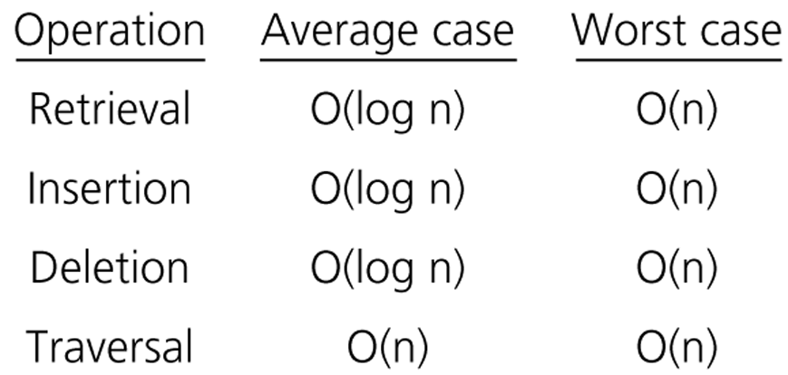
Order of Operations on BSTs

Slide 62
Treesort
We can use a binary search tree to sort an array.
treesort(inout anArray:ArrayType, in n:integer)
// Sorts n integers in an array anArray
// into ascending order
Insert anArray’s elements into a binary search tree bTree
Traverse bTree in inorder. As you visit bTree’s nodes, copy their data items intosuccessive locations of anArray

Slide 63
Treesort Analysis
Inserting an item into a binary search tree:
Worst Case: O(n)
Average Case: O(log₂n)
Inserting n items into a binary search tree:
Worst Case: O(n²) ➔ (1+2+...+n) = O(n²)
Average Case: O(n*log₂n)
Inorder traversal and copy items back into array ➔ O(n)
Thus, treesort is
➔ O(n²) in worst case, and
➔ O(n*log₂n) in average case.
Treesort makes exactly the same comparisons of keys as quicksort when the pivot for each sublist is chosen to be the first key.

Slide 64
Saving a BST into a file, and restoring it to its original shape
Save:
Use a preorder traversal to save the nodes of the BST into a file.
Restore:
Start with an empty BST.
Read the nodes from the file one by one, and insert them into the BST.

Slide 65
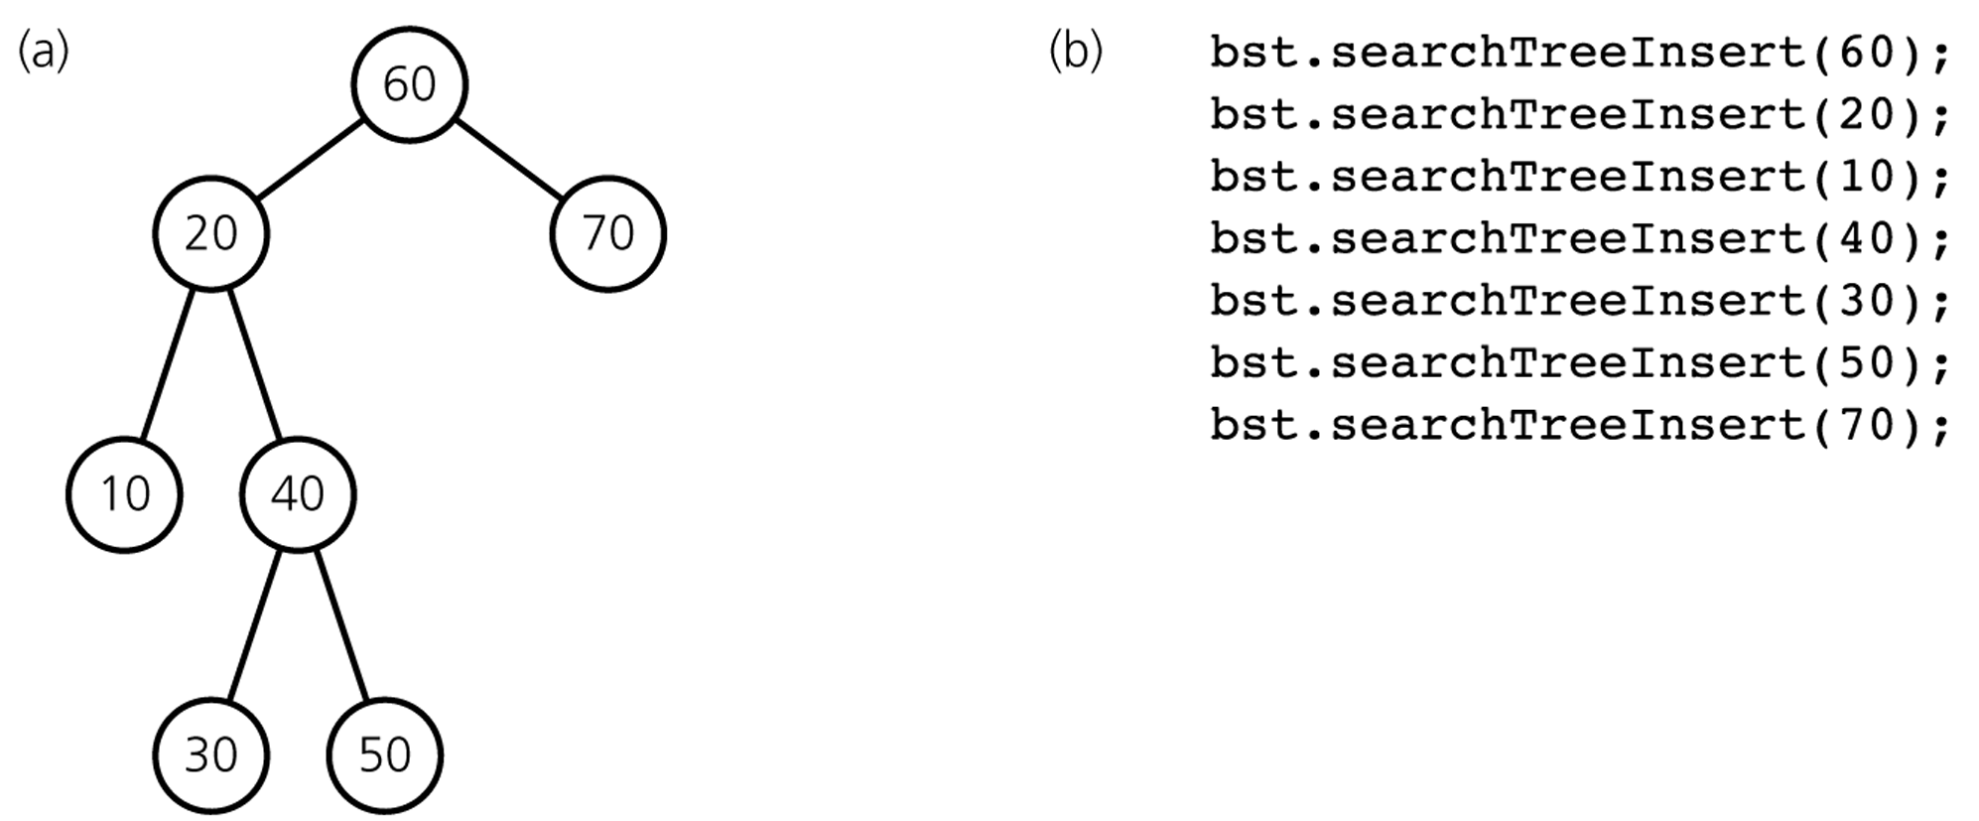
Saving a BST into a file, and restoring it to its original shape
Preorder: 60 20 10 40 30 50 70

Slide 66
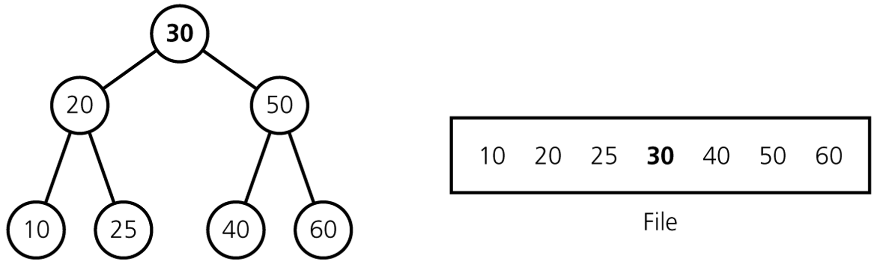
Saving a BST into a file, and restoring it to a minimum-height BST
Save:
Use an inorder traversal to save the nodes of the BST into a file. The saved nodes will be in ascending order.
Save the number of nodes (n) in somewhere.
Restore:
Read the number of nodes (n).
Start with an empty BST.
Put middle element to root, set its left and right BSTs recursively.

Slide 67
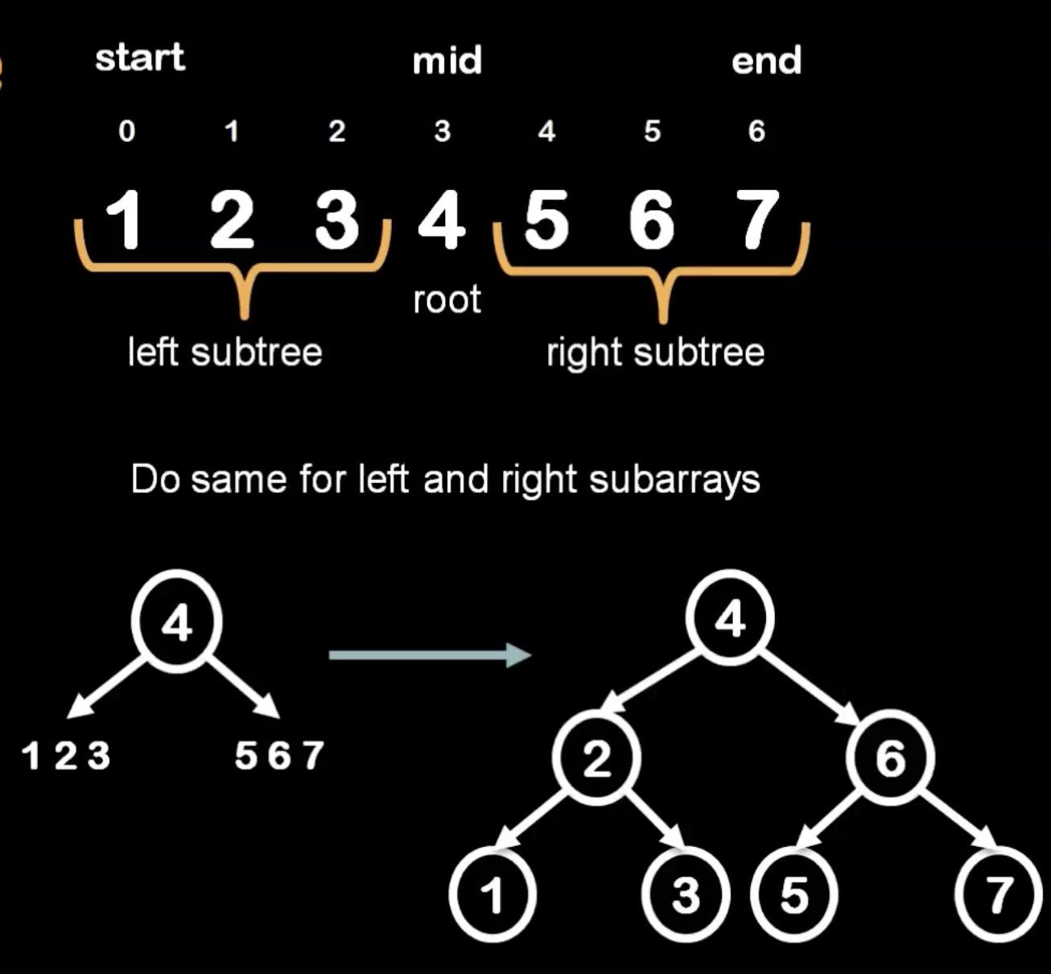
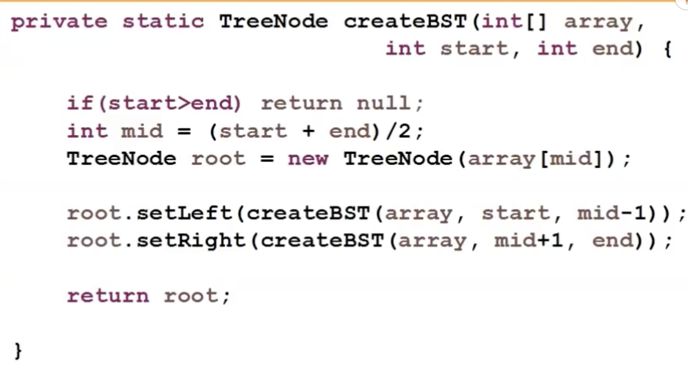
Building a minimum-height BST

Slide 68
B-Trees
B-tree is a special kind of tree, similar to a binary search tree where each node holds entries of some type.
But a B-tree is not a binary tree:
nodes can have more than two children
Nodes can contain more than just a single entry
Rules of B-tree make it easy to search for an item.
Also ensures that the leaves do not become too deep.

Slide 69
B-tree: Example
93 and 107
subtree
number 0
subtree
number 1
subtree
number 2
Each entry in subtree 0 is less than 93
Each entry in subtree 2 is greater than 107
Each entry in subtree 1 is between 93 and 107

Slide 70
B-tree Rules
1. Every node has at least MINIMUM number of entries. MINIMUM can be as small as 1, or as big as 100’s or 1000’s.
2. Maximum number of entries in a node is twice the value of MINIMUM.
3. The entries in a B-tree are stored in a partially-filled array, sorted from the smallest entry to the largest entry.
4. The number of subtrees below a node depends on how many entries are in the node.

Slide 71
B-tree: Rule 4
The number of subtrees below a node depends on how many entries are in the node.
93 and 107
subtree
number 0
subtree
number 1
subtree
number 2
Each entry in subtree 2 is greater than 107
Each entry in subtree 0 is less than 93
Each entry in subtree 1 is between 93 and 107

Slide 72
B-tree: Rule 5
For any non-leaf node: (a) an entry at index i is greater than all the entries in subtree number i of the node, and (b) an entry at index i is less than all the entries in subtree number i+1 of the node.
93 and 107
subtree
number 0
subtree
number 1
subtree
number 2
Each entry in subtree 2 is greater than 107
Each entry in subtree 0 is less than 93
Each entry in subtree 1 is between 93 and 107

Slide 73
B-tree: Rule 6
Every leaf in a B-tree has the same depth.
6
2 and 4
9
1
3
5
7 and 8
10

Slide 74
Operations on B-trees
Searching for an item: easy
Inserting item: see text
Removing item: see text
6
2 and 4
9
1
3
5
7 and 8
10

Slide 75
Binary Space Partitioning Tree
2D Example:
We are given a set of N points in the plane.
Each point has an associated (x,y) position.

Slide 76
Binary Space Partitioning Tree
Problem:
How to efficiently determine if a query point (x,y)
is contained in the set of points?
??

Slide 77
Possible Solutions
Go through N points comparing to see if their (x,y) value matches query point (x,y). Drawback: O(N) complexity.
Use some sort of tree structure to organize the points, and formulate query in terms of searching tree. Assuming uniform distribution of points, O(logN) complexity.
How to structure tree??? Partition space using Binary Space Partitioning (BSP).

Slide 78
Building BSP Tree
Approach:
Recursively split space in half, in such a way that
number of points in each half is roughly equal.

Slide 79
Building BSP Tree
Approach:
Recursively split space in half, in such a way that
number of points in each half is roughly equal.

Slide 80
Building BSP Tree
Approach:
Recursively split space in half, in such a way that
number of points in each half is roughly equal.

Slide 81
Building BSP Tree
Approach:
Recursively split space in half, in such a way that
number of points in each half is roughly equal.

Slide 82
Building BSP Tree
Recursively divide set of points using planes positioned that split the point set roughly in half.
Stop recursively dividing when set is empty, or set is smaller than threshold M, or maximum tree depth is reached.

Slide 83
BSP Tree
Result:

Slide 84
BSP Tree Search
Is there a point in set that matches query point (x,y)?

Slide 85
BSP Tree Search
Is there a point in set that matches query point (x,y)?

Slide 86
BSP Tree Search
Is there a point in set that matches query point (x,y)?

Slide 87
BSP Tree Search
Is there a point in set that matches query point (x,y)?

Slide 88
BSP Tree Search
Compare query point only
with those points in this leaf node.

Slide 89
BSP Tree Search: Complexity
Assume that points are randomly, uniformly distributed in space (within some range).
We recursively split point set in half at each internal node.
For analysis, assume that we allow trees of unlimited depth, and that each leaf can contain only one point.
Average case complexity, given N points?

Slide 90
Game Trees
Consider writing a computer program that plays Tic-Tac-Toe against a human...
human makes first move...
where should the computer move???
There are 8 possible choices.
X

Slide 91
Game Trees
The computer can make 8 possible moves
X
Each possible choice represents one
node at that level in the game tree.
Which one should be chosen??

Slide 92
Game Trees
The computer can make 8 possible moves
X
Each possible choice represents one
node at that level in the game tree.
Which one should be chosen??

Slide 93
Game Tree: Look Ahead
For each possible move, see what possible moves are for opponent.
For instance:
X
O
Each node represents a possible move
that the opponent could take.

Slide 94
Game Tree: Look Ahead
Proceed recursively, testing all possible moves until opponent or computer wins.
X
O
X
Choose a move that leads to the most
possible winning moves!!

Slide 95
Game Trees
For each turn in the game, build game tree that tests possible move scenarios.
Choose move that maximizes number of possible wins.
Parts of the tree are reusable (depending on the opponents choice of next move).
Problem: tree is quite large. Assume we have N=9 possible positions, what is the potential size O(f(N)) number of nodes?

Slide 96
Preorder Traversal
A traversal visits the nodes of a tree in a systematic manner
In a preorder traversal, a node is visited before its descendants
Application: print a structured document
Algorithm preOrder(v)
visit(v)
for each child w of v
preorder (w)
Root-left-right
(for binary trees)
Make Money Fast!
1
2
5
9
1. Motivations
2. Methods
References
3
4
6
7
8
1.1 Greed
1.2 Avidity
2.1 Stock Fraud
2.2 Ponzi Scheme
2.3 Bank Robbery

Slide 97
Postorder Traversal
In a postorder traversal, a node is visited after its descendants
Application: compute space used by files in a directory and its subdirectories
Algorithm postOrder(v)
for each child w of v
postOrder (w)
visit(v)
left-right-Root
(for binary trees)
9
course/
8
3
7
homeworks/
programs/
todo.txt 1K
1
2
4
5
6
h1c.doc 3K
h1nc.doc 2K
DDR.java 10K
Stocks.java 25K
Robot.java 20K

Slide 98
Inorder Traversal
In an inorder traversal, left node is visited followed by the Root followed by the right node (binary)
Application: fast sorting on binary search trees
Algorithm inOrder(v)
if(v == NULL) return
inOrder (v.left)
visit(v)
inOrder (v.right)
4
80
left-Root-right
(applicable to only binary trees only)
2
7
40
100
1
3
5
8
20
50
90
120
6
95

Slide 99
Binary Tree Traversals
Preorder Traversal
the node is visited before its left and right subtrees,
Postorder Traversal
the node is visited after both subtrees.
Inorder Traversal
the node is visited between the subtrees,
Visit left subtree, visit the node, and visit the right subtree.

Slide 100
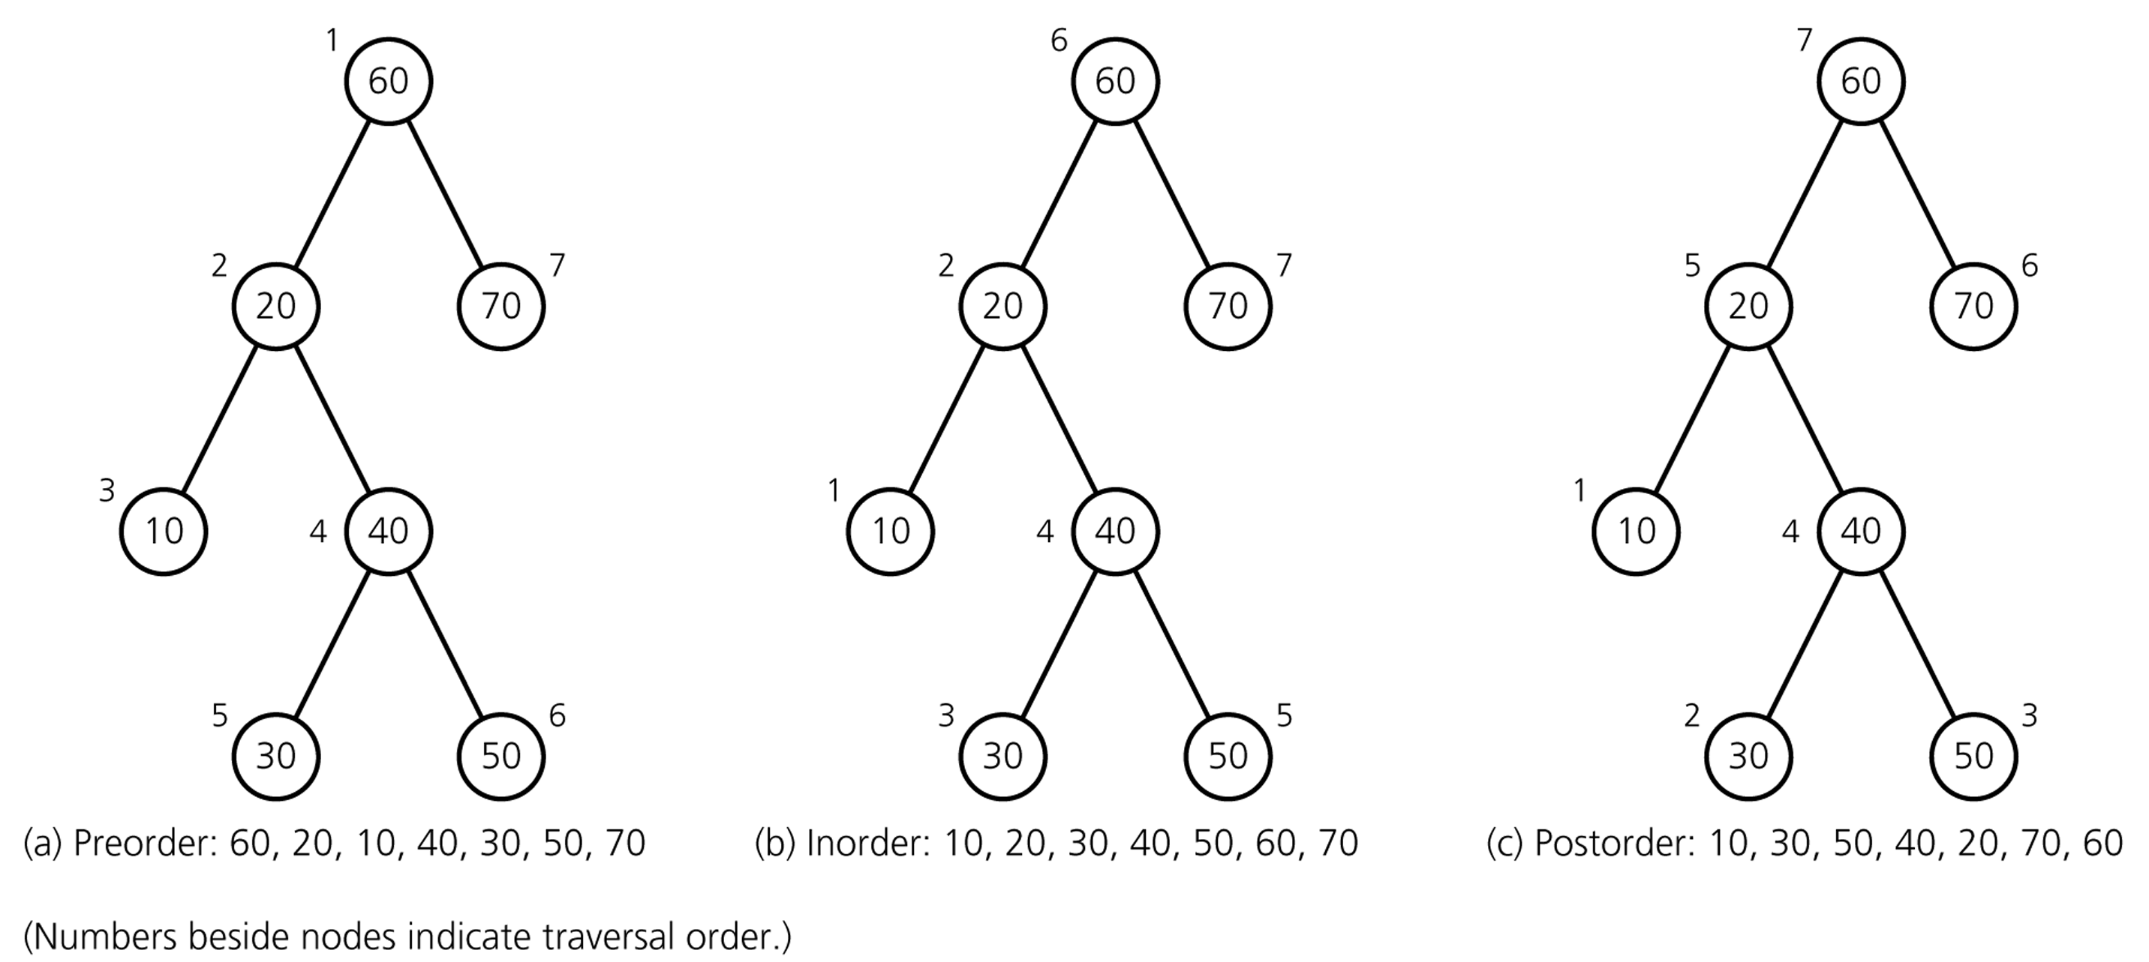
Binary Tree Traversals

Slide 101
Preorder
void preorder(struct tree_node * p)
{ if (p !=NULL) {
cout << p->data << endl;
preorder(p->left_child);
preorder(p->right_child);
}
}

Slide 102
Inorder
void inorder(struct tree_node *p)
{ if (p !=NULL) {
inorder(p->left_child);
cout << p->data << endl;
inorder(p->right_child);
}
}

Slide 103
Postorder
void postorder(struct tree_node *p)
{ if (p !=NULL) {
postorder(p->left_child);
postorder(p->right_child);
cout << p->data << endl;
}
}

Slide 104
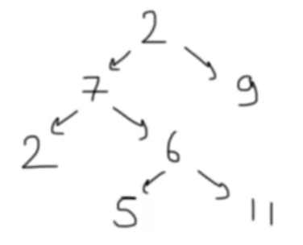
Finding the maximum value in a binary tree
int FindMax(struct tree_node *p)
{
int root_val, left, right, max;
max = -1; // Assuming all values are positive integers
if (p!=NULL) {
root_val = p -> data;
left = FindMax(p ->left_child);
right = FindMax(p->right_child);
// Find the largest of the three values.
if (left > right)
max = left;
else
max = right;
if (root_val > max)
max = root_val;
}
return max;
}

Slide 105
Adding up all values in a Binary Tree
int add(struct tree_node *p)
{
if (p == NULL)
return 0;
else
return (p->data + add(p->left_child)+
add(p->right_child));
}

Slide 106
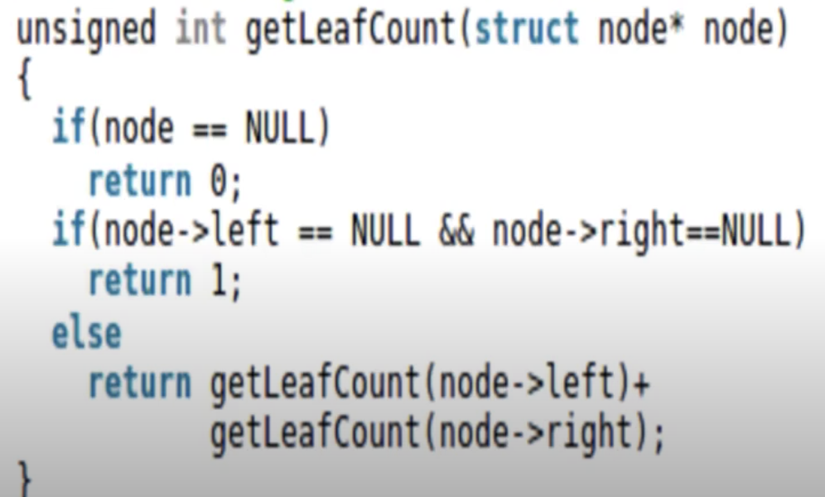
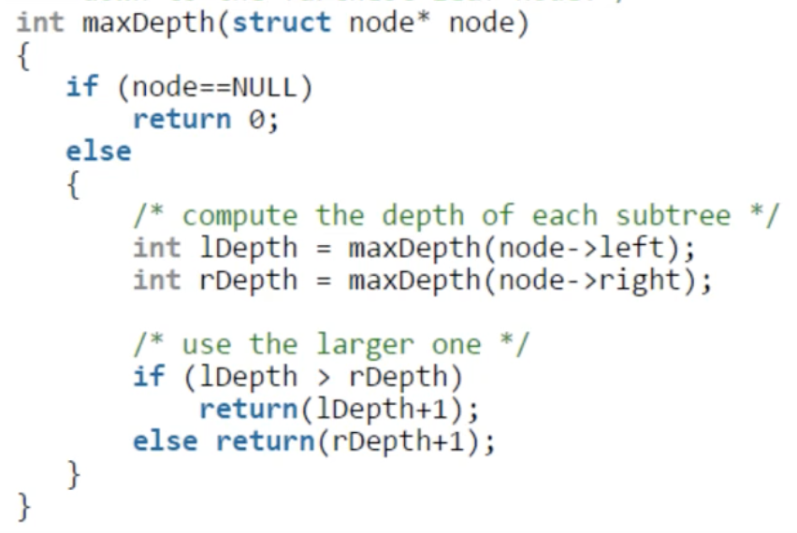
Exercises
Write a function that will count the leaves of a binary tree. Only left leaves?
Write a function that’ll find the height of a BT.
-1

Slide 107
Tree Traversal
Pre order – process parent before children
Post order – process parent after children
In order – process left subtree, parent, right subtree
‘C’
Pre order: C A T
Post order: A T C
In order: A C T
‘A’
‘T’

Slide 108
In-Order Traversal
Process the nodes in the left subtree with a recursive call
Process the root
Process the nodes in the right subtree with a recursive call

Slide 109
Implementation
template <class Item>
void inorder_print(BinaryTreeNode<Item> * node_ptr)
{
if(node_ptr != NULL)
{
inorder_print(node_ptr->left);
cout << node_ptr->data << endl;
inorder_print(node_ptr->right);
}
}

Slide 110
‘A’
‘L’
‘G’
root_ptr
‘O’
‘R’
‘T’
data ‘A’
left
right
data ‘L’
data ‘G’
left
right
left
right
data ‘O’
data ‘R’
data ‘T’
left
right
left
right
left
right

Slide 111
‘A’
‘L’
‘G’
root_ptr
‘O’
‘R’
‘T’
data ‘A’
left
right
data ‘L’
data ‘G’
left
right
left
right
data ‘O’
data ‘R’
data ‘T’
left
right
left
right
left
right

Slide 112
‘A’
O
‘L’
‘G’
root_ptr
‘O’
‘R’
‘T’
data ‘A’
left
right
data ‘L’
data ‘G’
left
right
left
right
data ‘O’
data ‘R’
data ‘T’
left
right
left
right
left
right

Slide 113
‘A’
O L
‘L’
‘G’
root_ptr
‘O’
‘R’
‘T’
data ‘A’
left
right
data ‘L’
data ‘G’
left
right
left
right
data ‘O’
data ‘R’
data ‘T’
left
right
left
right
left
right

Slide 114
‘A’
O L R
‘L’
‘G’
root_ptr
‘O’
‘R’
‘T’
data ‘A’
left
right
data ‘L’
data ‘G’
left
right
left
right
data ‘O’
data ‘R’
data ‘T’
left
right
left
right
left
right

Slide 115
‘A’
O L R A
‘L’
‘G’
root_ptr
‘O’
‘R’
‘T’
data ‘A’
left
right
data ‘L’
data ‘G’
left
right
left
right
data ‘O’
data ‘R’
data ‘T’
left
right
left
right
left
right

Slide 116
‘A’
O L R A G
‘L’
‘G’
root_ptr
‘O’
‘R’
‘T’
data ‘A’
left
right
data ‘L’
data ‘G’
left
right
left
right
data ‘O’
data ‘R’
data ‘T’
left
right
left
right
left
right

Slide 117
‘A’
O L R A G T
‘L’
‘G’
root_ptr
‘O’
‘R’
‘T’
data ‘A’
left
right
data ‘L’
data ‘G’
left
right
left
right
data ‘O’
data ‘R’
data ‘T’
left
right
left
right
left
right

Slide 118
In-order Traversal of Binary Search Trees
5
3
10
453
55
600
2
4
6
11
9
62
In order traversal:
2, 3, 4, 5, 6, 10, 11
In order traversal:
9, 55, 62, 453, 600

Slide 119
Representing Equations As Binary Trees
Each internal node stores a binary operator
Each leaf stores a value (or variable)
*
+
-
6
-
*
/
2
22
2
22
5
22
5
In order traversal:
(22 – 2) + (22*5)
In order traversal:
((22/5) – 2)*6

Slide 120
Pre-Order Traversal
Process the nodes in the left subtree with a recursive call
Process the nodes in the right subtree with a recursive call
Process the root

Slide 121
Implementation
template <class Item>
void preorder_print(BinaryTreeNode<Item> * node_ptr)
{
if(node_ptr != NULL)
{
preorder_print(node_ptr->left);
preorder_print(node_ptr->right);
cout << node_ptr->data << endl;
}
}

Slide 122
Post-Order Traversal
Process the root
Process the nodes in the left subtree with a recursive call
Process the nodes in the right subtree with a recursive call

Slide 123
Implementation
template <class Item>
void postorder_print(BinaryTreeNode<Item> * node_ptr)
{
if(node_ptr != NULL)
{
cout << node_ptr->data << endl;
postorder_print(node_ptr->left);
postorder_print(node_ptr->right);
}
}

Slide 124
Binary Tree Traversals
Inorder Traversal rule:
A
B
C
A: B and C’s parent node, and it’s the root node of the three nodes.
B: A’s left child node
C: A’s right child node
For each node print “left child node→root node→ right child node”

Slide 125
Binary Tree Traversals
Inorder Traversal
+
Void inorder(tree_pointer ptr){
If(ptr){
inorder(ptr->left_child);
printf(“%d”, ptr->data);
inorder(ptr->right_child);
}
}
*
E
*
D
/
C
A
B
NULL

Slide 126
Binary Tree Traversals
Inorder Traversal
+
Void inorder(tree_pointer ptr){
If(ptr){
inorder(ptr->left_child);
printf(“%d”, ptr->data);
inorder(ptr->right_child);
}
}
1
*
E
2
3
1
2
3
1
2
3
*
D
/
C
A
B
NULL

Slide 127
Binary Tree Traversals
Inorder Traversal
+
Void inorder(tree_pointer ptr){
If(ptr){
inorder(ptr->left_child);
printf(“%d”, ptr->data);
inorder(ptr->right_child);
}
}
4
*
E
5
6
4
5
6
1
2
3
4
5
*
D
/
C
A
B
NULL

Slide 128
Binary Tree Traversals
Inorder Traversal
+
Void inorder(tree_pointer ptr){
If(ptr){
inorder(ptr->left_child);
printf(“%d”, ptr->data);
inorder(ptr->right_child);
}
}
6
*
E
6
1
2
3
4
5
*
D
5
5
/
C
A
B
A
NULL

Slide 129
Binary Tree Traversals
Inorder Traversal
+
Void inorder(tree_pointer ptr){
If(ptr){
inorder(ptr->left_child);
printf(“%d”, ptr->data);
inorder(ptr->right_child);
}
}
5
*
E
6
5
6
1
2
3
4
5
*
D
4
4
/
C
A
B
A
/
NULL

Slide 130
Binary Tree Traversals
Inorder Traversal
+
Void inorder(tree_pointer ptr){
If(ptr){
inorder(ptr->left_child);
printf(“%d”, ptr->data);
inorder(ptr->right_child);
}
}
6
*
E
6
1
2
3
5
*
D
5
4
5
/
C
A
B
A
/
B
NULL

Slide 131
Binary Tree Traversals
Inorder Traversal
+
Void inorder(tree_pointer ptr){
If(ptr){
inorder(ptr->left_child);
printf(“%d”, ptr->data);
inorder(ptr->right_child);
}
}
4
*
E
4
1
2
3
4
*
D
3
3
/
C
A
B
A
/
B
*
NULL

Slide 132
Binary Tree Traversals
Inorder Traversal
+
Void inorder(tree_pointer ptr){
If(ptr){
inorder(ptr->left_child);
printf(“%d”, ptr->data);
inorder(ptr->right_child);
}
}
5
*
E
5
1
2
4
*
D
4
3
4
/
C
A
B
A
/
B
*
C
NULL

Slide 133
Binary Tree Traversals
Inorder Traversal
+
Void inorder(tree_pointer ptr){
If(ptr){
inorder(ptr->left_child);
printf(“%d”, ptr->data);
inorder(ptr->right_child);
}
}
*
E
1
2
*
D
2
3
2
4
/
C
A
B
A
/
B
*
C
*
NULL

Slide 134
Binary Tree Traversals
Inorder Traversal
+
Void inorder(tree_pointer ptr){
If(ptr){
inorder(ptr->left_child);
printf(“%d”, ptr->data);
inorder(ptr->right_child);
}
}
3
*
E
4
3
4
1
3
*
D
3
3
2
3
/
C
A
B
A
/
B
*
C
*
D
NULL

Slide 135
Binary Tree Traversals
Inorder Traversal
+
Void inorder(tree_pointer ptr){
If(ptr){
inorder(ptr->left_child);
printf(“%d”, ptr->data);
inorder(ptr->right_child);
}
}
4
*
E
4
1
*
D
1
2
1
3
/
C
A
B
A
/
B
*
C
*
D
+
NULL

Slide 136
Binary Tree Traversals
Inorder Traversal
+
Void inorder(tree_pointer ptr){
If(ptr){
inorder(ptr->left_child);
printf(“%d”, ptr->data);
inorder(ptr->right_child);
}
}
2
*
E
3
2
3
2
*
D
2
1
2
/
C
A
B
A
/
B
*
C
*
D
+
E
NULL

Slide 137
Binary Tree Traversals
Inorder Traversal
+
Void inorder(tree_pointer ptr){
If(ptr){
inorder(ptr->left_child);
printf(“%d”, ptr->data);
inorder(ptr->right_child);
}
}
3
*
E
3
*
D
1
2
/
C
A
B
A
/
B
*
C
*
D
+
E
NULL

Slide 138
Binary Tree Traversals
Inorder Traversal
Preorder Traversal rule:
A
/
B
*
C
*
D
+
E
A
B
C
For each node print “root node→left child node→right child node”
As the same way, we can get：
+
*
*
/
A
B
C
D
E

Slide 139
Binary Tree Traversals
Inorder Traversal rule:
Preorder Traversal
Postorder Traversal
A
A
/
B
*
C
*
D
+
E
B
C
+
*
*
/
A
B
C
D
E
For each node print “left child node→right child node→root node”
As the same way, we can get：
A
B
/
C
*
D
*
E
+

Slide 140
Binary Tree Traversals
Inorder Traversal
Preorder Traversal
Postorder Traversal
A
/
B
*
C
*
D
+
E
+
*
*
/
A
B
C
D
E
A
B
/
C
*
D
*
E
+

Slide 141
Level Order Traversal of a Binary Tree
1.Prepare a tree and a queue,
f: front r:rear
2.Add root to queue
A
3.Get node from the queue and print data,
then add the left and right child to queue
B
C
D
E
F
G
H
I
A
J
K
L
f
r
f
r
NULL
A

Slide 142
Level Order Traversal of a Binary Tree
1.Prepare a tree and a queue,
f: front r:rear
2.Add root to queue
A
3.Get node from the queue and print data,
then add the left and right child to queue
B
C
4.Go to step 3 until node is NULL
D
E
F
G
H
I
A
B
J
K
L
r
f
f
r
r
r
NULL
E
B
C
D

Slide 143
Level Order Traversal of a Binary Tree
1.Prepare a tree and a queue,
f: front r:rear
2.Add root to queue
A
3.Get node from the queue and print data,
then add the left and right child to queue
B
C
4.Go to step 3 until node is NULL
D
E
F
G
H
I
A
B
C
D
J
K
L
r
r
f
r
f
f
NULL
E
F
G
C
D

Slide 144
Level Order Traversal of a Binary Tree
1.Prepare a tree and a queue,
f: front r:rear
2.Add root to queue
A
3.Get node from the queue and print data,
then add the left and right child to queue
B
C
4.Go to step 3 until node is NULL
D
E
F
G
5.If child node is NULL, skip and not to
add to queue
H
I
A
B
C
D
E
F
J
K
L
f
f
f
r
r
f
NULL
E
F
G
H

Slide 145
Level Order Traversal of a Binary Tree
1.Prepare a tree and a queue,
f: front r:rear
2.Add root to queue
A
3.Get node from the queue and print data,
then add the left and right child to queue
B
C
4.Go to step 3 until node is NULL
D
E
F
G
5.If child node is NULL, skip and not to
add to queue
A
B
C
D
E
F
G
H
H
I
I
J
K
L
r
r
f
f
r
f
r
NULL
J
K
H
I

Slide 146
Level Order Traversal of a Binary Tree
1.Prepare a tree and a queue,
f: front r:rear
2.Add root to queue
A
3.Get node from the queue and print data,
then add the left and right child to queue
B
C
4.Go to step 3 until node is NULL
D
E
F
G
5.If child node is NULL, skip and not to
add to queue
A
B
C
D
E
F
G
H
I
J
K
H
I
L
J
K
L
f
f
r
f
r
f
NULL
J
K
L

Slide 147
Level Order Traversal of a Binary Tree
1.Prepare a tree and a queue,
f: front r:rear
2.Add root to queue
A
3.Get node from the queue and print data,
then add the left and right child to queue
B
C
4.Go to step 3 until node is NULL
D
E
F
G
5.If child node is NULL, skip and not to
add to queue
A
B
C
D
E
F
G
H
I
J
K
H
I
L
J
K
If queue is empty, the node would get NULL
and break the loop
L
f
r
NULL

Slide 148
Example Iterative In-order Traversal

Slide 149
Iterative Inorder Traversal
1.First, we prepare a array stack and a binary tree
2.Push the node to stack and find left child until NULL
A
B
C
D
E
F
G
H
I
D
J
K
B
A
L
NULL

Slide 150
Iterative Inorder Traversal
1.First, we prepare a array stack and a binary tree
D
2.Push the node to stack and find left child until NULL
3.If the node is NULL, pop top term from stack
4.Print the node and find right child
and go to step 2
A
B
C
D
E
F
G
H
I
D
H
J
K
B
A
L
NULL

Slide 151
Iterative Inorder Traversal
1.First, we prepare a array stack and a binary tree
D
H
B
2.Push the node to stack and find left child until NULL
3.If the node is NULL, pop top term from stack
4.Print the node and find right child
and go to step 2
A
5.If right child is NULL,
pop top term from stack
and go to step 4
B
C
D
E
F
G
H
I
H
J
K
B
E
A
L
NULL

Slide 152
Iterative Inorder Traversal
1.First, we prepare a array stack and a binary tree
D
H
B
E
A
2.Push the node to stack and find left child until NULL
3.If the node is NULL, pop top term from stack
4.Print the node and find right child
and go to step 2
A
5.If right child is NULL,
pop top term from stack
and go to step 4
B
C
D
E
F
G
H
I
J
K
F
E
A
L
C
NULL

Slide 153
Iterative Inorder Traversal
1.First, we prepare a array stack and a binary tree
D
H
B
E
A
F
C
2.Push the node to stack and find left child until NULL
3.If the node is NULL, pop top term from stack
4.Print the node and find right child
and go to step 2
A
5.If right child is NULL,
pop top term from stack
and go to step 4
B
C
D
E
F
G
H
I
J
K
F
I
C
L
G
NULL

Slide 154
Iterative Inorder Traversal
1.First, we prepare a array stack and a binary tree
D
H
B
E
A
F
C
J
I
2.Push the node to stack and find left child until NULL
3.If the node is NULL, pop top term from stack
4.Print the node and find right child
and go to step 2
A
5.If right child is NULL,
pop top term from stack
and go to step 4
B
C
D
E
F
G
H
I
J
J
K
K
I
G
L
NULL

Slide 155
Iterative Inorder Traversal
1.First, we prepare a array stack and a binary tree
D
H
B
E
A
F
C
J
I
K
L
2.Push the node to stack and find left child until NULL
3.If the node is NULL, pop top term from stack
4.Print the node and find right child
and go to step 2
A
5.If right child is NULL,
pop top term from stack
and go to step 4
B
C
D
E
F
G
H
I
J
K
K
L
G
L
NULL

Slide 156
Iterative Inorder Traversal
1.First, we prepare a array stack and a binary tree
D
H
B
E
A
F
C
J
I
K
L
G
2.Push the node to stack and find left child until NULL
3.If the node is NULL, pop top term from stack
4.Print the node and find right child
and go to step 2
A
5.If right child is NULL,
pop top term from stack
and go to step 4
B
C
D
E
F
G
6.If right child is NULL
and stack is empty,
stop the traversal
H
I
J
K
G
L
NULL

